Slide 1
TEAM NAME :
GUITAR

Slide 2
WIRELESS SENSOR NETWORK BASED SMART IRRIGATION SYSTEM:
PREPARED BY:
J.V.V.DURGA PRASAD (177Y1A05D0)
T.ANVITHA (187Y1A0468)
K.SWAPNA (187Y1A04B4)

Slide 3
ABSTRACT:
This paper on "Smart Irrigation System" is develop to create an automated irrigation mechanism which turns the pumping motor ON and OFF on detecting the moisture content of the earth using the soil moisture sensor without the intervention of human. The benefit of employing these techniques is to decrease human interference and it is quite feasible and affordable. This Smart irrigation system project is using a node mcu micro-controller, that is programmed to collect the input signal according to moisture content of the soil and its output is given to the that will operate the pump.
The key objective of the paper is to monitor the soil’s moisture content during its dry and wet conditions with the aid of a moisture sensor circuit, an automatic water inlet setup which can also monitor and record temperature, humidity and sunlight, which is constantly modified and can be controlled in future to optimize these resources so that the plant growth and yield is maximized.

Slide 4
INTRODUCTION:
In India, agriculture is the need of most of the Indians livelihood and it is one of the main sources of livelihood. Agriculture also has a major impact on economy of the country. The consumption of water increases day by day that may leads to the problem of water scarcity. To overcome this problem, we have implemented a new technique by using node mcu micro controller. In this project we are using soil moisture sensor which is used to sensing moisture level whether the soil is dry or wet. The moisture sensor is interface with node mcu micro controller that will work by the process of simulating on ARDUINO IDE software and based on that it activate the DC motor through op-amp which compare the level of moisture content of the soil with the reference value that will operate the pump through relay.. Water is a very precious resource and must be properly utilized. Agriculture is one of those areas which consume a lot of water.Agriculture is one of those areas which consume a lot of water. Irrigation is a time consuming process and must be done on a timely basis.The aim of the article is to develop an smart irrigation system

Slide 5
BLOCK DIAGRAM:
NODE MCU
IBM CLOUD
SOIL MOISTURE
DHT SENSOR
MOBILE APP
DC MOTOR

Slide 6
HARDWARE AND SOFTWARE COMPONENTS:
HARDWARE COMPONENTS:
1.NODE MCU
2.SOIL MOISTURE
3.DHT SENSOR
4.DC MOTOR
5.L293D MOTOR DRIVER

Slide 7
SOFTWARE COMPONENTS:
ARDUINO IDE
IBM CLOUD
IOT PLATFORM
NODE RED

Slide 8
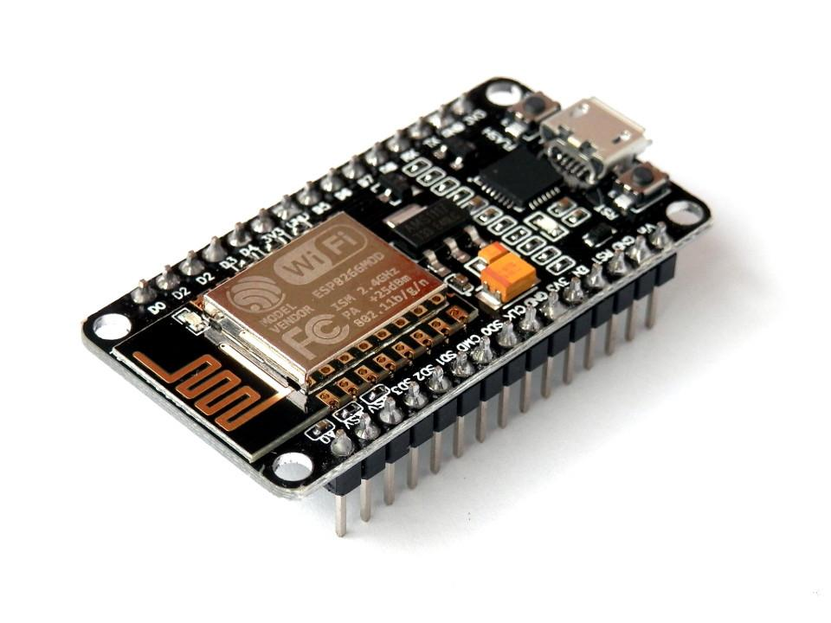
1.NODE MCU:
NodeMCU is an open source IoT platform. It includes firmware which runs on the ESP8266 Wi-Fi SoC from Espressif Systems, and hardware which is based on the ESP-12 module. The term "NodeMCU" by default refers to the firmware rather than the development kits. The firmware uses the Lua scripting language. It is based on the eLua project, and built on the Espressif Non-OS SDK for ESP8266. It uses many open source projects, such as lua-cjson and SPIFFS.The ESP8266 WiFi Module is a self contained SOC with integrated TCP/IP protocol stack that can give any microcontroller access to your WiFi network. The ESP8266 is capable of either hosting an application or offloading all Wi-Fi networking functions from another application processor. The NodeMCU (Node MicroController Unit) is an open source software and hardware development environment that is built around a very inexpensive System-on-a-Chip (SoC) called the ESP8266.

Slide 9
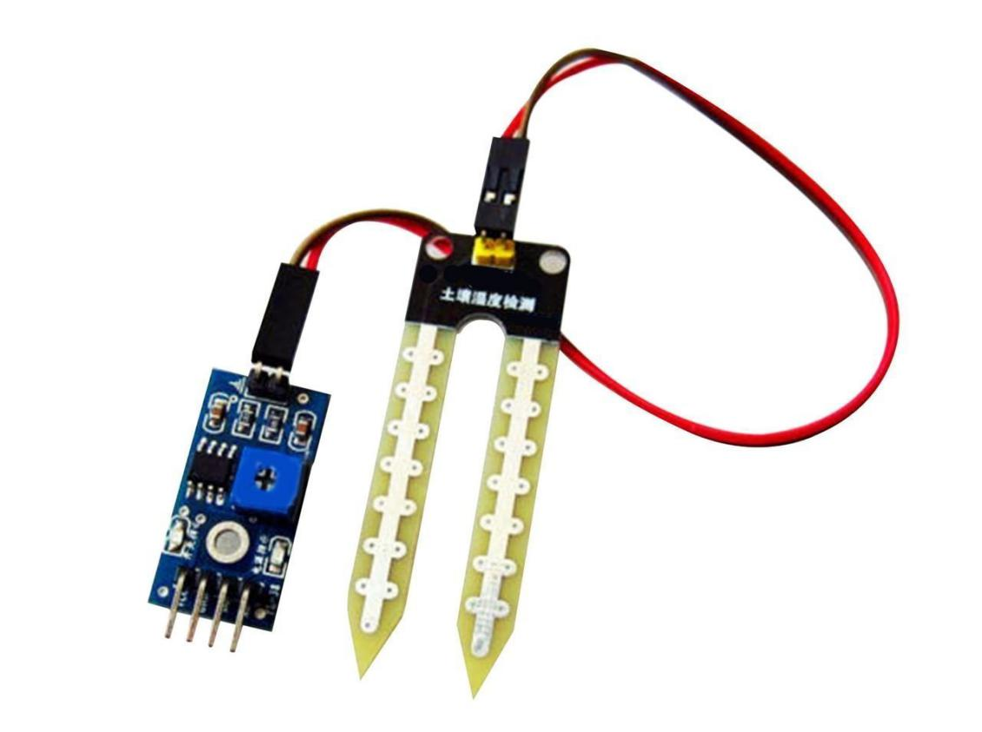
2.SOIL MOISTURE:
Soil moisture is basically the content of water present in soil. This can be measured using a soil moisture sensor which consists of two conducting probes that act as a probe. It can measure the moisture content in the soil based on the change in resistance between the two conducting plates.
The resistance between the two conducting plates varies in an inverse manner with the amount of moisture present in the soil.The sensormeasures the dielectric constant of the soil in order to find its volumetric water content (VWC5). urchase a basic soil moisture probe. Go to your local hardware store and look for a soil moisture probe or a soil moisture meter. ...
Push the probe into the soil and read the results. ...
Identify dry soil by a number lower than 5. ...
Spot moist soil by a number higher than

Slide 10
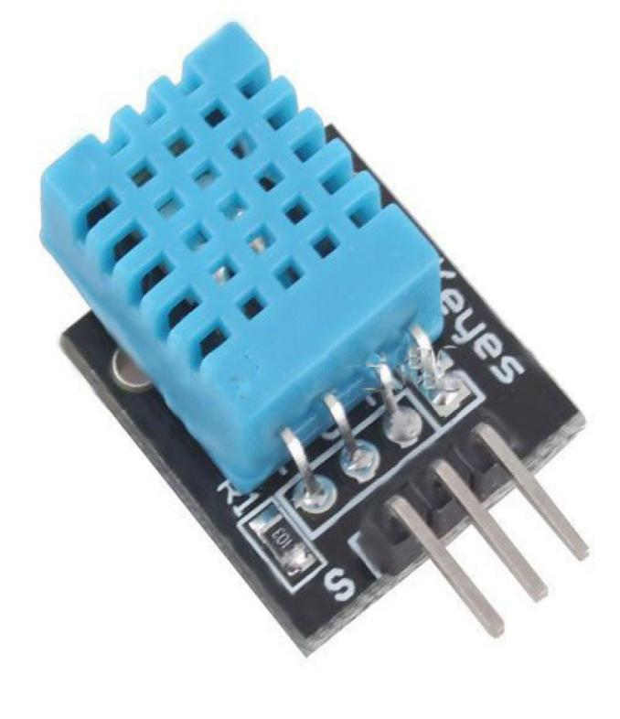
3.DHT SENSOR:
DHT11 sensor measures and provides humidity and temperature values serially over a single wire.It can measure relative humidity in percentage (20 to 90% RH) and temperature in degree Celsius in the range of 0 to 50°C.It has 4 pins; one of which is used for data communication in serial form.Pulses of different TON and TOFF are decoded as logic 1 or logic 0 or start pulse or end of frame.The electric connection to the NodeMCU is very simple, as the DHT series can be powered direct with 3.3V. Only 3 wires are needed: VCC, GND and the data line.

Slide 11
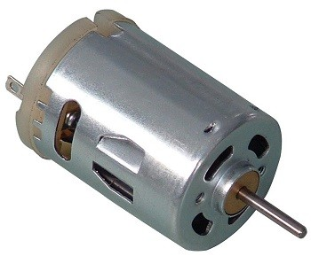
4.DC MOTOR:
DC motor converts electrical energy in the form of Direct Current into mechanical energy in the form of rotational motion of the motor shaft.
The DC motor speed can be controlled by applying varying DC voltage; whereas the direction of rotation of motor can be changed by reversing the direction of current through it.
For applying varying voltage, we can make use of PWM technique.For reversing the current, we can make use of H-Bridge circuit or motor driver ICs that employ the H-Bridge technique.NodeMCU based ESP8266 can be used to control the speed and rotational direction of DC Motor. NodeMCU has PWM feature on its GPIO pins using which we can control DC motor.

Slide 12
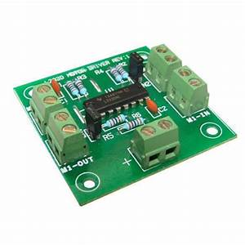
5.L293D MOTOR DRIVER:
A motor driver is an integrated circuit chip which is usually used to control motors in autonomous robots. Motor driver act as an interface between Arduino and the motors . The most commonly used motor driver IC’s are from the L293 series such as L293D, L293NE, etc. These ICs are designed to control 2 DC motors simultaneously. L293D consist of two H-bridge. H-bridge is the simplest circuit for controlling a low current rated motor. We will be referring the motor driver IC as L293D only. L293D has 16 pins.

Slide 13
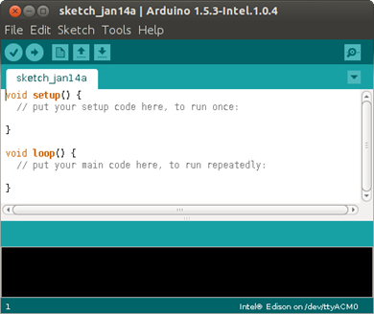
ARDUINO IDE:
The Arduino integrated development environment (IDE) is a cross-platform application (for Windows, macOS, Linux) that is written in the programming language Java. It is used to write and upload programs to Arduino compatible boards, but also, with the help of 3rd party cores, other vendor development boards.The source code for the IDE is released under the GNU General Public License, version 2. The Arduino IDE supports the languages C and C++ using special rules of code structuring.

Slide 14

IBM CLOUD:
IBM Cloud is an accelerated virtual desktop infrastructure software that is integrated with industry-standard graphics and storage capabilities to eliminate productivity barriers. The platform empowers mobile workforces to gain workstation-like experience on any device for fast and convenient access to graphics-intensive applications and files anytime and anywhere there is an internet connection. IBM Cloud is a suite of cloud computing services from IBM that offers both platform as a service (PaaS) and infrastructure as a service (IaaS). With IBM Cloud IaaS, organizations can deploy and access virtualized IT resources -- such as compute power, storage and networking The IBM SmartCloud brand includes infrastructure as a service, software as a service and platform as a service offered through public, private and hybrid cloud delivery models. IBM places these offerings under three umbrellas: SmartCloud Foundation, SmartCloud Services and SmartCloud Solutions.

Slide 15
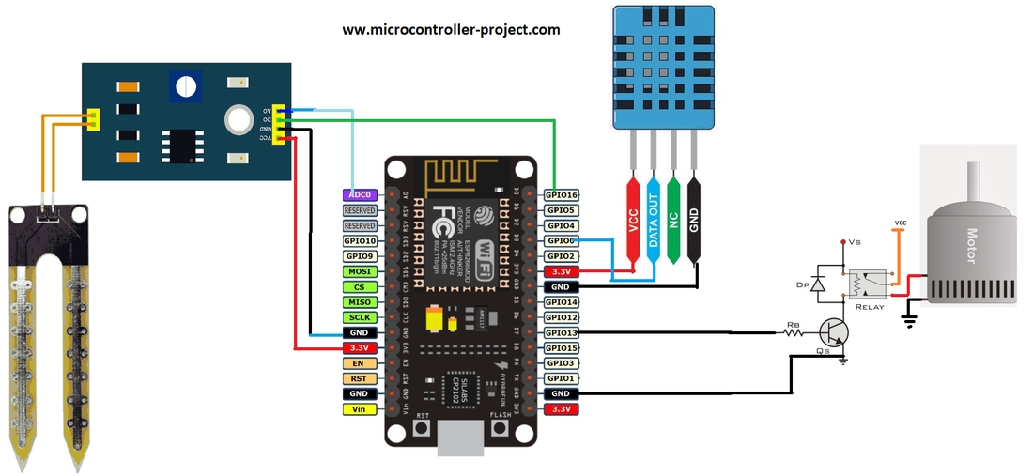
DIAGRAM:

Slide 16
BASIC ADVANTAGES:
1.One of the greatest advantages of a smart irrigation system is its ability to save water.
2.The first thing that a smart irrigation system will save you is money. You’re paying for water and perhaps even sewer costs, and you want to make sure you’re getting the most from every penny you spend. Smart irrigation ensures that you have to use up to 70% less water. That means spending 70% less money to water your business’ lawn and plants.

Slide 17
CONCLUSION:
1.THE smart irrigation system is feasible and cost effective for optimizing water resources for agricultural production
2.This irrigation system allows cultivation in places with water scarcity thereby improving
Sustainability
3.It proves that the use of water can be diminished
4.The use of solar power in this system is significantly important for organic crops

Slide 18
THANK YOU

